Slide 1

Yahoo! Open Hack Day 2009
Location Plus!
Team 8: Happy Summer
賴弘哲 Jimmy
陳健文 Chienwen
吳嘉祥 Grassboy

Slide 2



往往會不知道該聊些什麼話題
因為彼此的生活圈沒有交集…
當我們剛認識遠地而來的朋友，

Slide 3
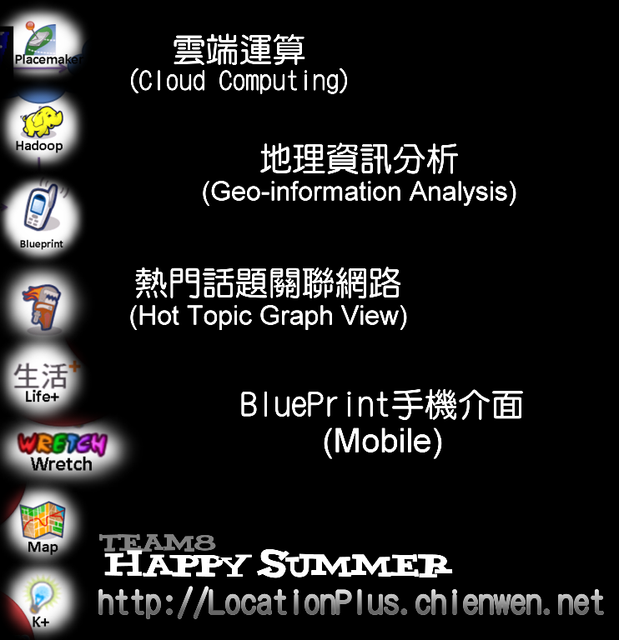

Slide 4
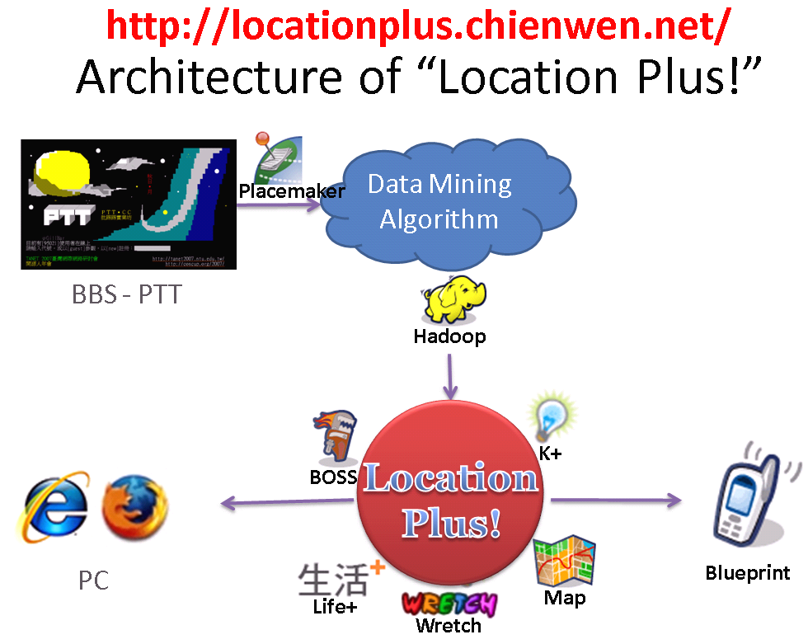

Slide 5
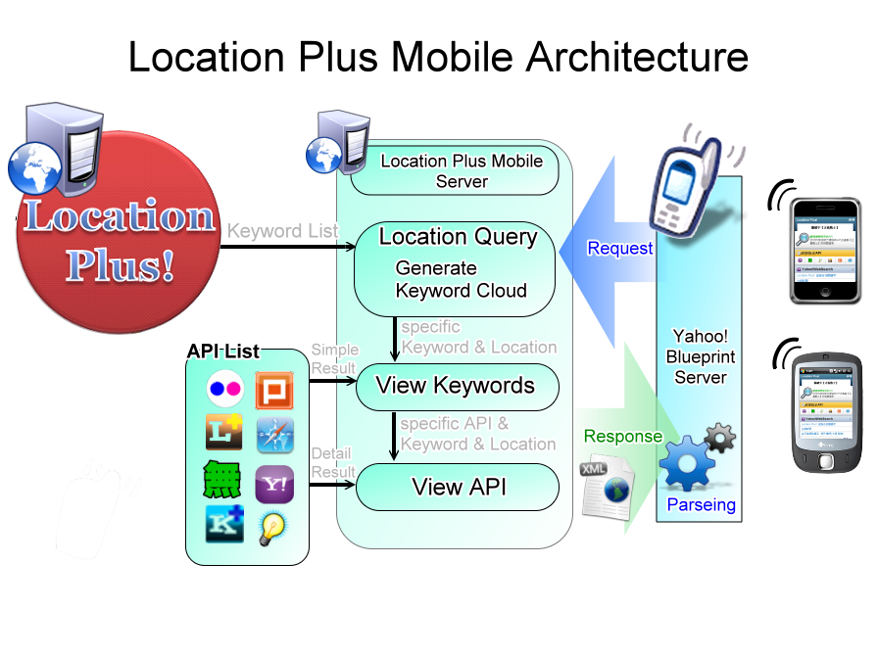

Slide 6
About Location Plus Mobile
Advantage
  Using Blueprint: Mobile phone independent
  More application by getting GPS Information
    Directly show what happened around your location
    Location tagging
    Connecting you with somebody around you
Disadvantage
  Too many API-call in ViewKeyword page
  Blueprint server parses the blueprint XML page and translates to HTML code is a time consuming work

